Slide 1
Important Note
For each Requirement R1-R4 you must sketch your visualization idea using example images and drawings (no actual implementation)
For each solution you must provide one arguments why your solution supports users to perform the associated analytical tasks (arguments can be textual and visual)

Slide 2
Requirement R1
Add here your sketch

Slide 3
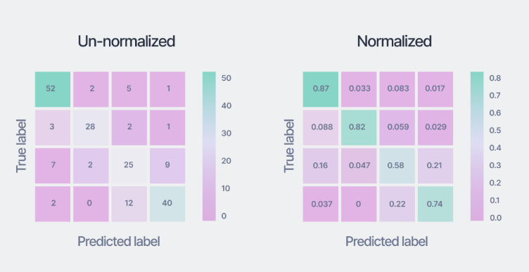
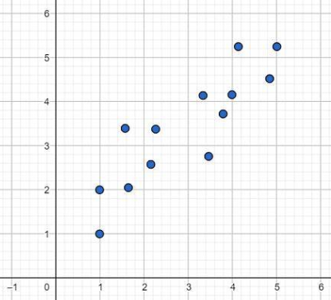
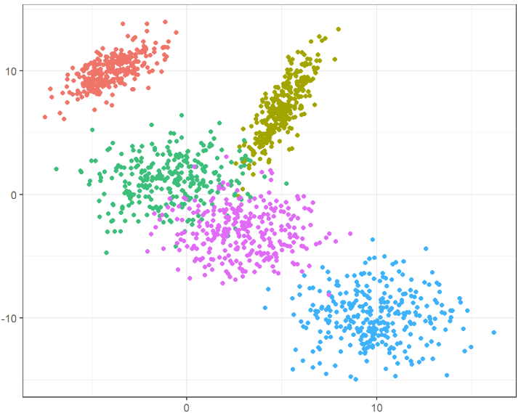

Requirement R2
- Confusion Matrix on 5x5 Base (5 different labels)
Clicking on a cell: Two scatter plots in a new window
1. Plot: True Labels
2. Plot: Predicted Labels with class highlighting and max 5 labels
Optional filtering for visualized Classes
As a dropdown above
True Classes
Very Low
Low
Moderate
High
Very High
Predicted Classes
Very Low
Low
Moderate
High
Very High
Clicking of a DP:
Printing the features of the dp in a format xy in another window
E.g. JSON

Slide 4
Requirement R3
Add here your sketch

Slide 5
Requirement R4
Add here your sketch

Slide 6
Requirement R5
Add here your sketch

Slide 7
Requirement R6
Add here your sketch

Slide 8
Requirement R1-R6
- Req. 3: Class Performance Visualization through Confusion Matrix, Specific Error Visualization through scatter plots

